Slide 1
JavaScript API: Tips and Tricks
Tableau Developer Video Series
JavaScript API

Slide 2
JavaScript API Video Series
JSAPI Introduction
JSAPI Tutorial
Companion Content: http://github.com/tableau/JSAPIVideos
Embedding & Interactions
Tips & Tricks

Slide 3
At the end of this video you will...
Understand common ‘gotchas’ with the JSAPI
Know how to use asynchronous functions in the JSAPI
Know how to create event listeners with the JSAPI

Slide 4
Understanding API Versions
Tableau Server version | JavaScript API .js files
8.0 | tableau_v8.js tableau_v8.debug.js
9.0 | tableau-2.0.0.min.js tableau-2.0.0.js
9.1 | tableau-2.min.js tableau-2.js
Source: http://onlinehelp.tableau.com/current/api/js_api/en-us/help.htm

Slide 6
Handling Dashboards

Slide 7
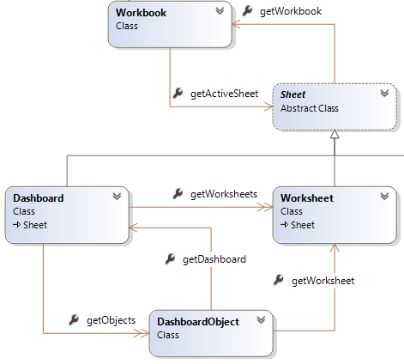
Handling Dashboards
Source: http://onlinehelp.tableau.com/current/api/js_api/en-us/help.htm

Slide 8
Asynchronous Programming
onFirstInteractive
Execute some code after the viz loads
.then()
Execute some code after a JSAPI function finishes

Slide 9
Event Listeners
Execute some code when the user does something:
Marks Selection
Tab Switch
Filter Change
Parameter Value Change
Story Point Switch
Custom View Interaction
Viz Resize

Slide 10
Developer Resources
Tableau Developer Portal (http://developers.tableau.com)
JavaScript API Developer Docs
Hands-on Introductory Tutorial
Community Forum
Other Videos: #DataDev YouTube
JS API Series Content (http://github.com/tableau/JSAPIVideos)
Notes:
The Tableau Developer Portal (http://developers.tableau.com) is the one-stop shop for everything related to APIs and extensibility. You can find links to the JSAPI docs, examples, a hands-on tutorial, and forums for discussing the JavaScript API.

